Slide 1
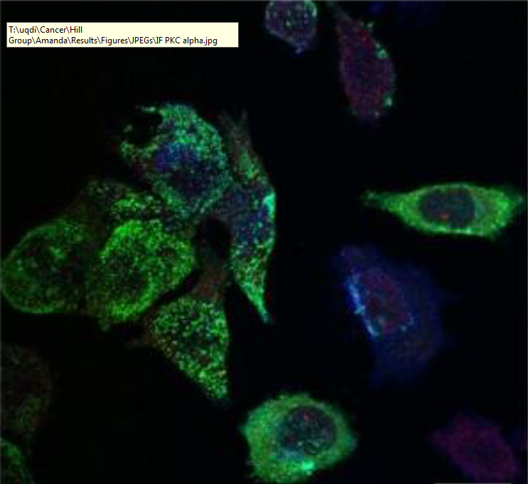
Selective export of microRNA via extracellular vesicles
Harley Robinson
Supervisor: Dr Michelle Hill
Co-supervisor: Dr Alex Cristino

Slide 2
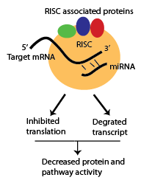
microRNAs
Important regulatory mechanism
Binding to target mRNA decreases protein function by RISC inhibition and degradation
Export of microRNAs (miRs, miRNAs) regulates pathways in the recipient cells attributed to:
Cardiac homeostasis
Diabetes
Cancer metastasis
Notes:
RISC- RNA induced silencing complex.
Risc associated proteins: argonates, Dicer,

Slide 3
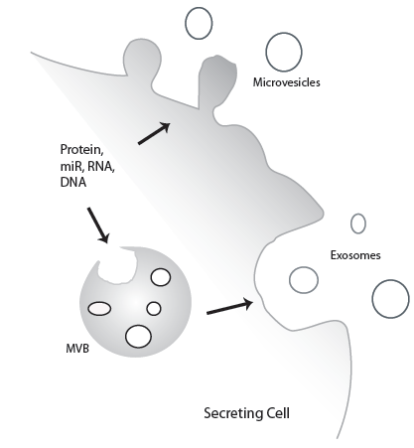
Extracellular vesicles
Composed of microvesicles and exosomes.
Content regulate processes in recipient cells.
Surface contains homing proteins to allow for cell specific delivery
Important for intercellular communication.

Slide 4
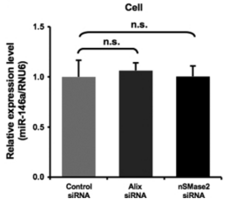
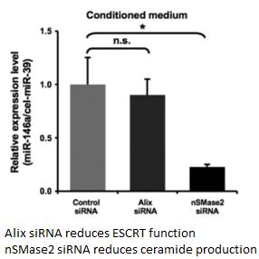
Current miRNA Cargo Loading Mechanisms.
Little information known regarding
sorting.
Ceramide dependent
ESCRT-independent
RNA-binding protein: Sumoylated hnRNP A2B1 involved in export to EVs
Regulation and binding partners are still unknown.
Notes:
hnRNP- 30 exoMiRS out of 2587 total

Slide 5
Advanced Prostate Cancer Cell Line: PC3
Increased Caveolin-1 expression, without Cavins.
Caveolin-1 is a cholesterol transporter
When accompanied by Cavin-1, it will form caveolae, utilised in Endocytosis.
Caveolin-1 is a proposed biomarker for cancer.

Slide 6
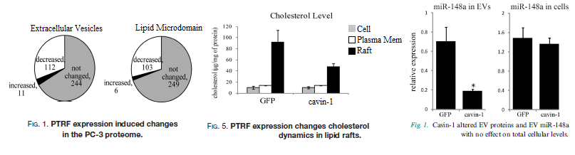
Cavins and lipid rafts
- Introduction of Cavin-1 results in modulated cholesterol re-distribution, EV protein content and miR content.
Cholesterol and ceramide are enriched with lipid microdomains (raft) found on the surface of EVs.
RNA-binding proteins appear to be enriched within lipid rafts.
Hereby, modulation of miRNA export could be lipid raft dependent.

Slide 7
Hypotheses and Aims:
It is hypothesised that the introduction of Cavin-1 to a PC3 model will modify the EV miRNA content due to a modification of RNA binding protein.
Aims:
Identify the miRNAs that are selectively exported
Identify RNA-binding proteins correlated to the miRNA export
Verify candidate miRNA escort proteins ability to bind to miRNAs and transport to EVs.

Slide 8
Aim 1: Analysis of miRNA export
Method 1: Bioinformatic Analysis.
Previous miRNA-seq data compiled for cell and EV fraction of PC3 GFP cells and PC3 cavin-1 transfected cells.
Using R packages to find fold change differences between Cavin-1 and GFP
Compare FC of cavin-1/GFP between cell and EV to find differentially exported miRs.
 | microRNA | baseMean | log2FoldChange | lfcSE | stat | pvalue | padj
Cell | hsa-miR-X | 58.297218 | 2.229358867 | 0.471440906 | 4.72882 | 2.26E-06 | 0.000276
EV | hsa-miR-X | 22.9440875 | 5.311894876 | 0.562070815 | 9.45058 | 3.90E-05 | 0.002001

Slide 9
Aim 1: Analysis of miRNA export. Cont.
Method 2: RT-qPCR
Using kits
Addition of poly-A tail
cDNA conversion
Average triplicates
Compare GFP to Cavin-1 to find Fold Change
T-Test

Slide 10
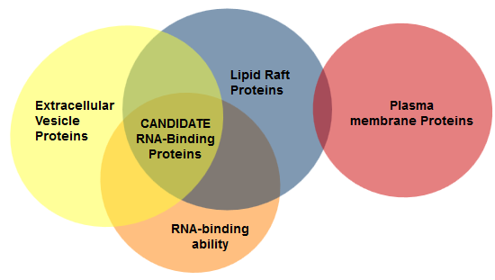
Aim 2: Identify candidate miR binding proteins.
Method 1: Computational analysis.
Previous proteomics data collected for the lipid raft, plasma membrane and EVs using tandem mass spectrometry for PC3 GFP and PC3 cavin-1 cells.
Identifying proteins enriched in the EV fraction correlating to an increase of miR export.
Perform Gene Ontology analyses to identify molecular function: RNA-binding ability.
Notes:
GO:0003723

Slide 11

Aim 2: Identify candidate miR binding proteins. cont.
Method 2: Motif discovery.
Literature search for known binding motif of candidate protein.
Alternatively…
Gibbs sampling to find shared motif in exported miRNAs
Probability based algorithm.
Expect a motif shared between all the exported miRNAs.
miR-198; GGUCCAGAGGGGAGAUAGGUUC
miR-887; CUUGGGAGCCCUGUUAGACUC

Slide 12
Aim 3: Verification of miR Candidate.
Method 1: Pull down assay

Slide 13
Aim 3: Verification of miR Candidate. Cont.
Method 2: Co-localisation by Immunofluorescence Confocal Microscopy

Slide 14
Significance

